Slide 1
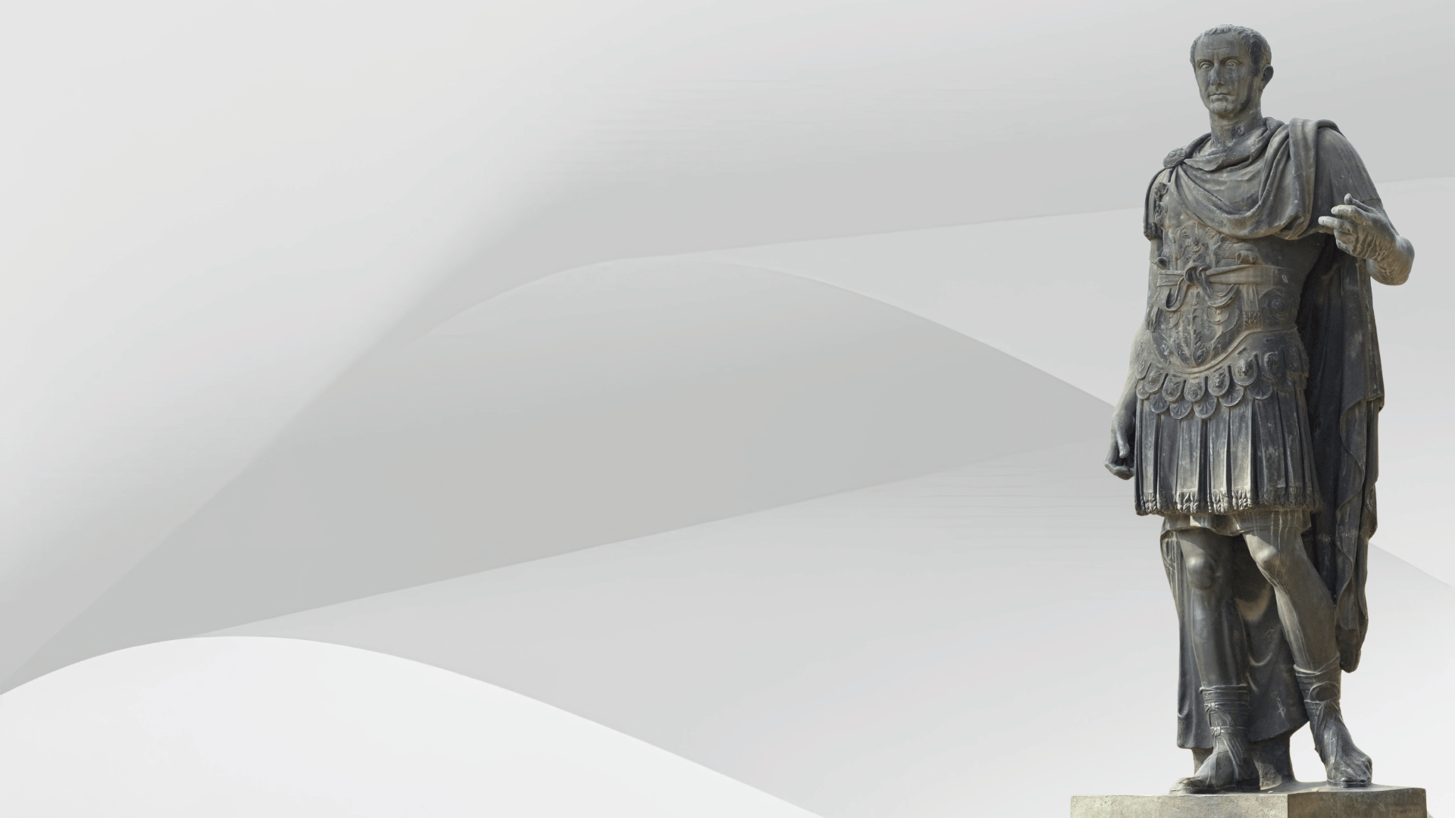
Them, Me, HIM
Luke 7:1-10
Matthew 8:5-13

Slide 2
Them
The first assessment of character is made by others (7:3-5)
Romans 12:18; 1 Timothy 3:7;
1 Peter 2:13-16
Does your character cause others to speak ill of God?
Romans 2:23-24

Slide 3
Me
We must be willing to assess our own character (7:6-7)
Colossians 4:1; 1 Peter 5:5-6;
James 4:6; Proverbs 22:4
God values the quality of humility a great deal more than men

Slide 4
HIM
We must remember Christ is the ultimate Judge (7:9)
Luke 17:5-6; James 1:5-8;
James 5:16-18
Will Jesus find in us the type of
faith He requires?
Luke 18:8

Slide 5
Concluding Thought
Our character will be noted by others, and should be examined by ourselves.
Ultimately, Jesus Christ will judge us!
“well done good and faithful servant”

